Slide 1
House Rental Price prediction
Shaik. Arshad Ansari

Slide 2
Project Goals:
Objective: To analyze and predict house rent prices based on various features.
Context: In a dynamic real estate market, understanding the factors influencing rent prices is crucial for tenants, landlords, and policymakers.
Significance: Our project aims to provide insights that can aid in making informed decisions related to renting and investing in properties.
Key Components:
We will delve into a comprehensive dataset containing details about property types, locations, amenities, and other crucial factors.
By leveraging predictive modeling, we aim to uncover relationships between these features and rental prices.

Slide 3
Tools:
Python
Jupyter Notebooks
Pandas
NumPy
Matplotlib
Seaborn
Scikit-learn
XGBoost (for regression modeling)

Slide 4
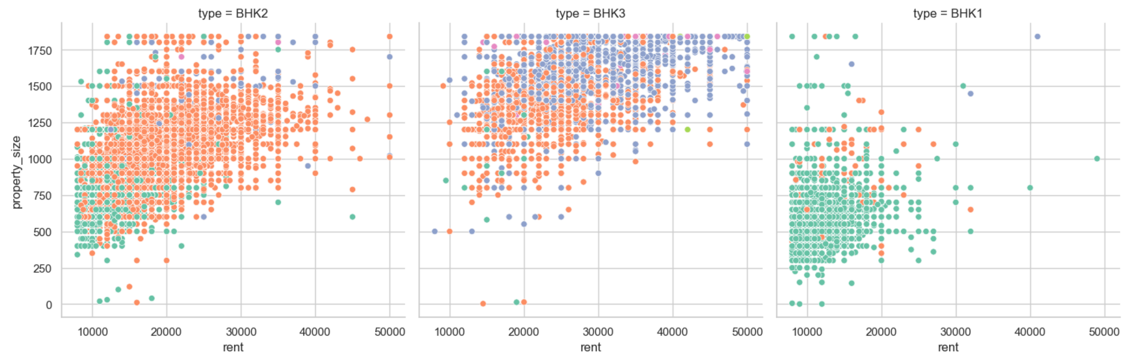
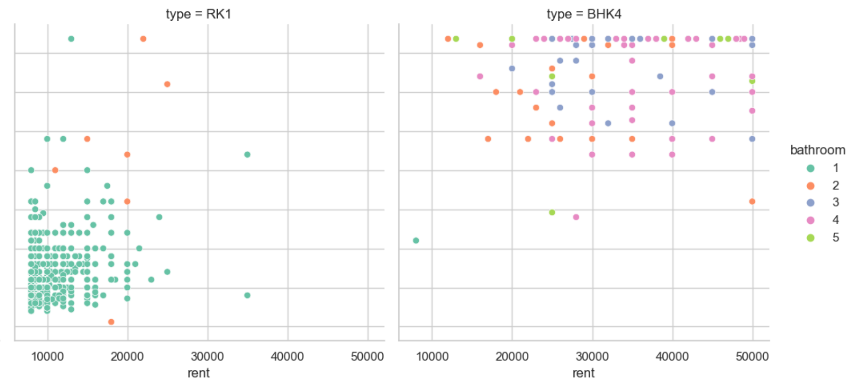
1. Correlation Analysis:
- How does the number of bedrooms and bathrooms affect the rent price?
sns.relplot(data=data, x="rent", y="property_size", hue='bathroom', col="type", palette="Set2")

Slide 5
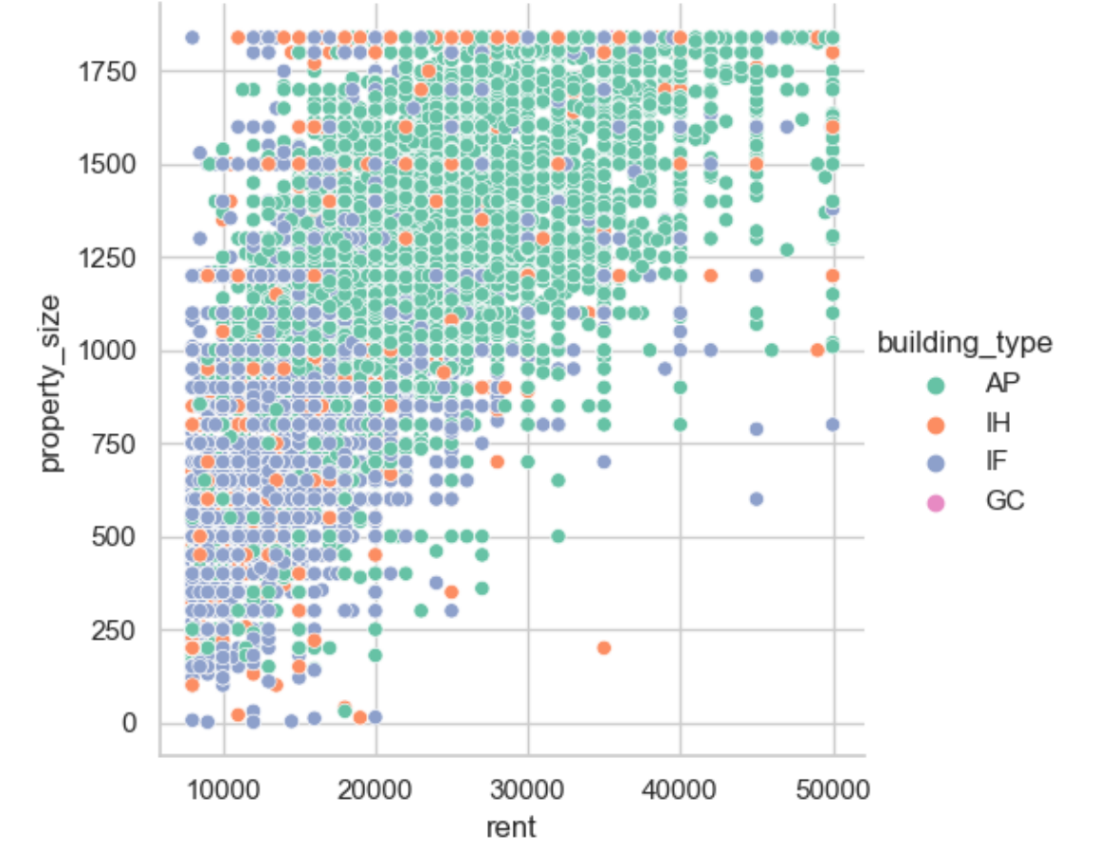
- Is there a correlation between the property size and rent price?
sns.relplot(data=data, x="rent", y="property_size", hue="building_type", palette="Set2")
Correlation between property size and rent price: 0.75765

Slide 6
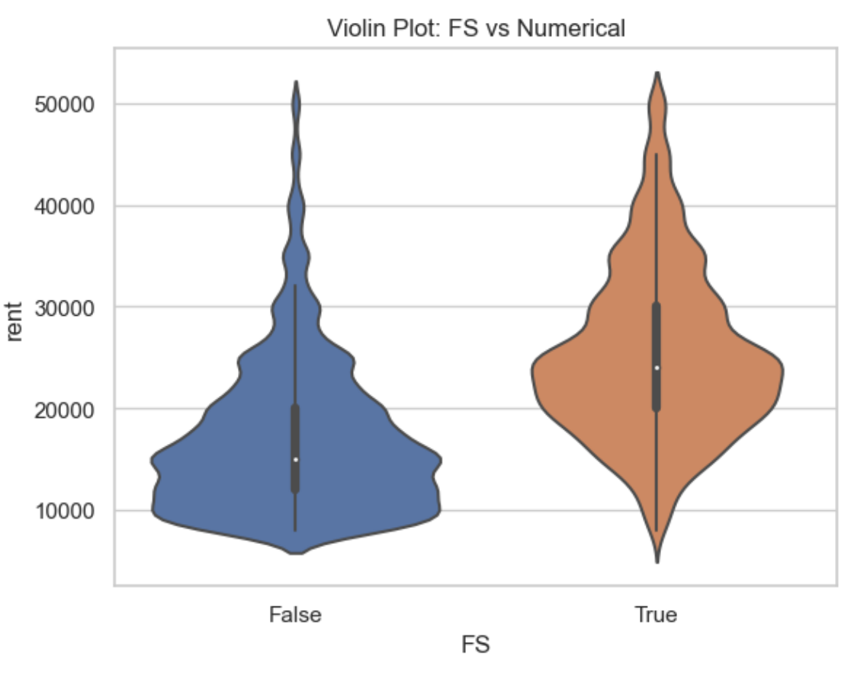
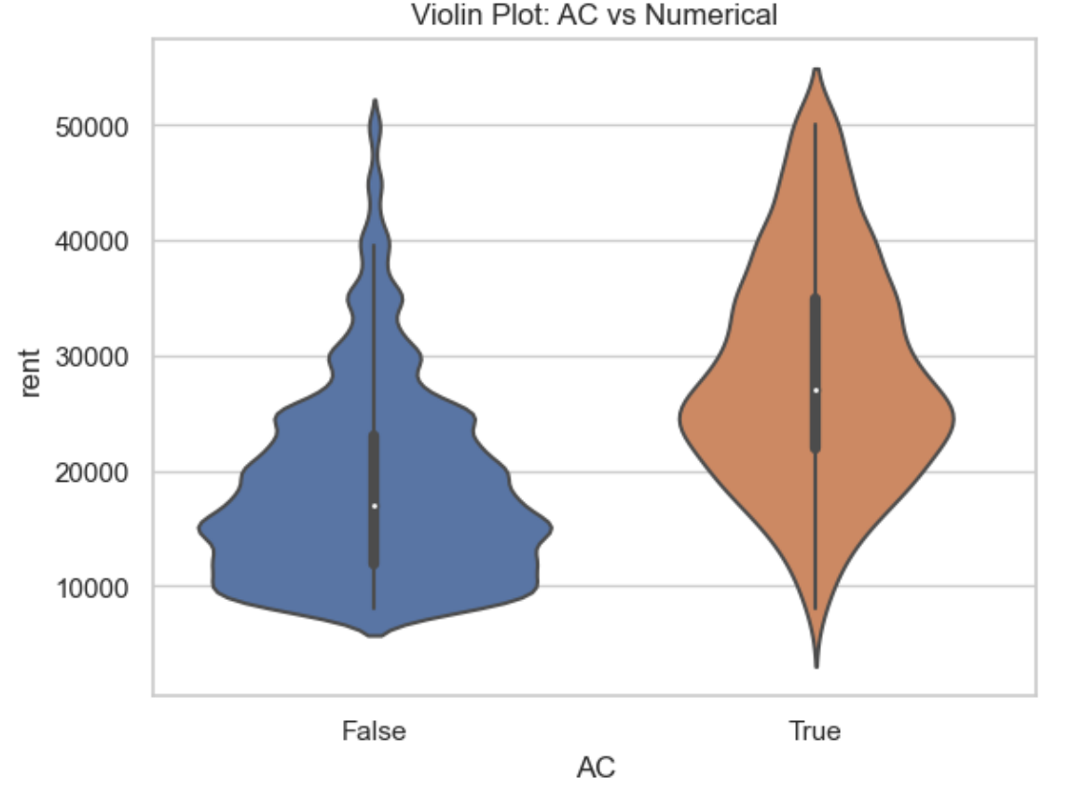
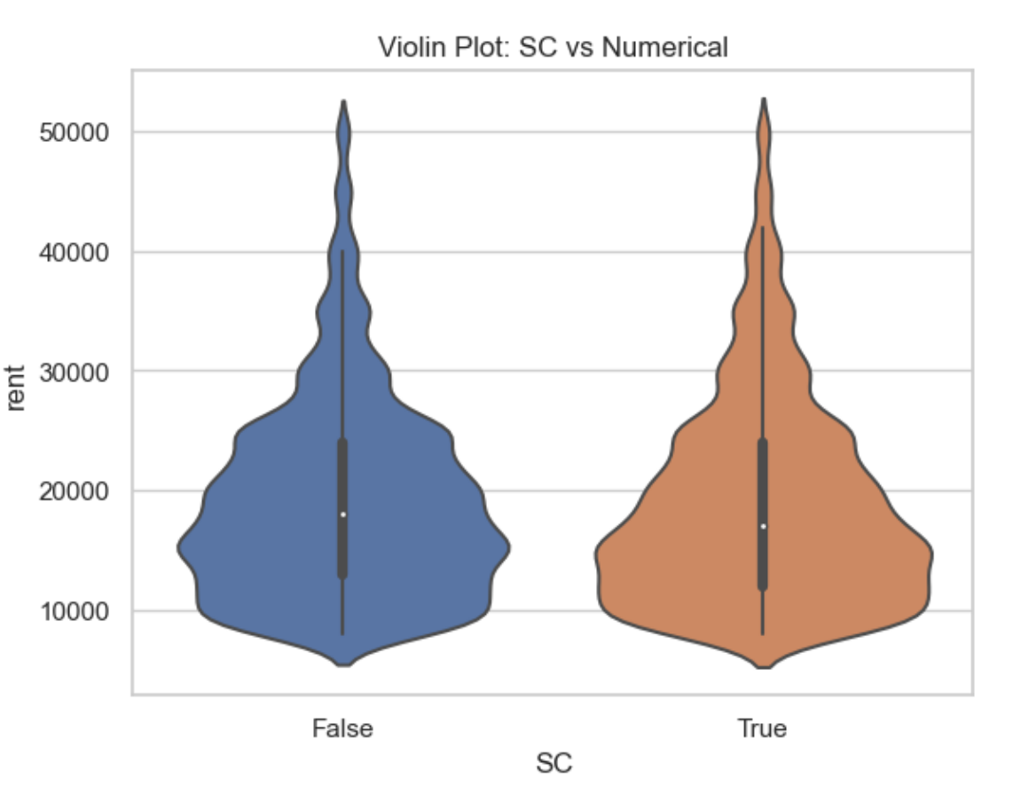
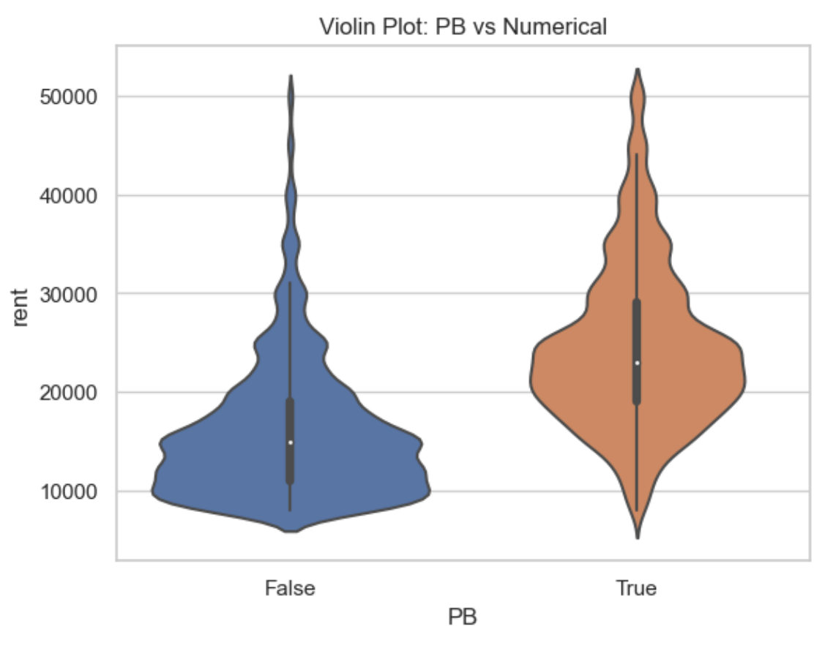
- Do properties with more amenities tend to have higher rent prices?
'{"LIFT":true, "GYM":true, "INTERNET":true, "AC":false, ”CLUB”:true, "INTERCOM":true, "POOL":true, "CPA":true, "FS":true, "SERVANT":false, "SECURITY":true, "SC":true, "GP":true, "PARK":falsese, "CLUB":true, "RWH":true, "STP":true, "HK":false, "PB":true, "VP":true}’
Average rent with AC: 28433
Average rent without AC: 18637
Average rent with FS: 25299
Average rent without FS: 17133
Average rent with SC: 18969
Average rent without SC: 19134
Average rent with PB: 24425
Average rent without PB: 15963

Slide 7
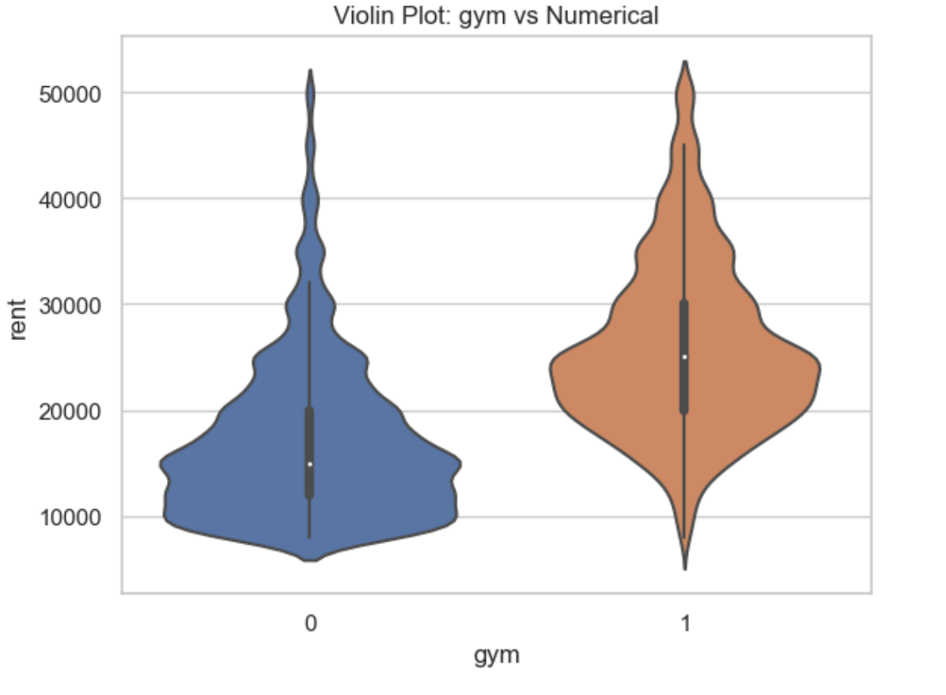
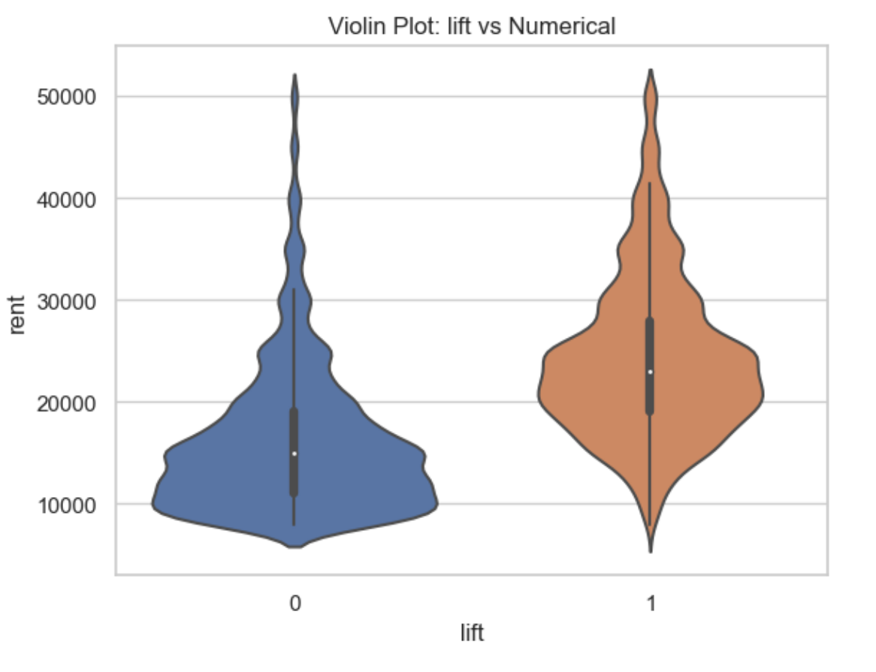
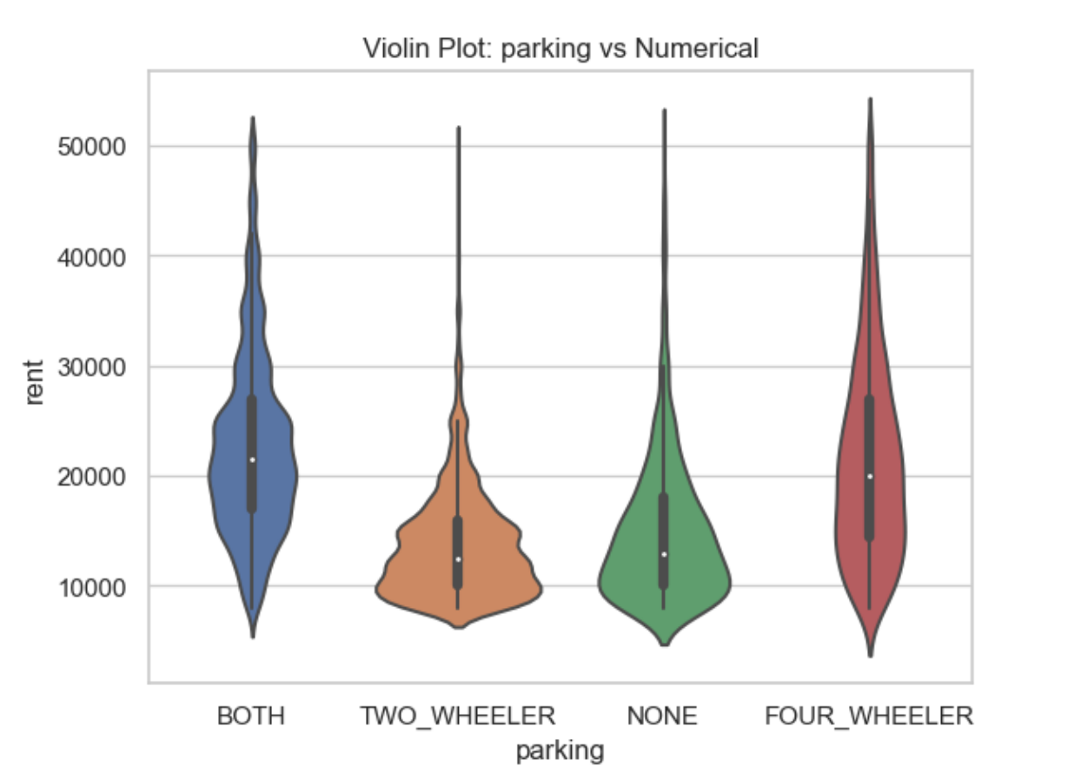
Property Features and Rent:
- How does the presence of certain features like a gym, lift, or parking affect the rent price?
Average rent with gym: 25776
Average rent without gym: 17085
Average rent with lift: 24230
Average rent without lift: 16123

Slide 8
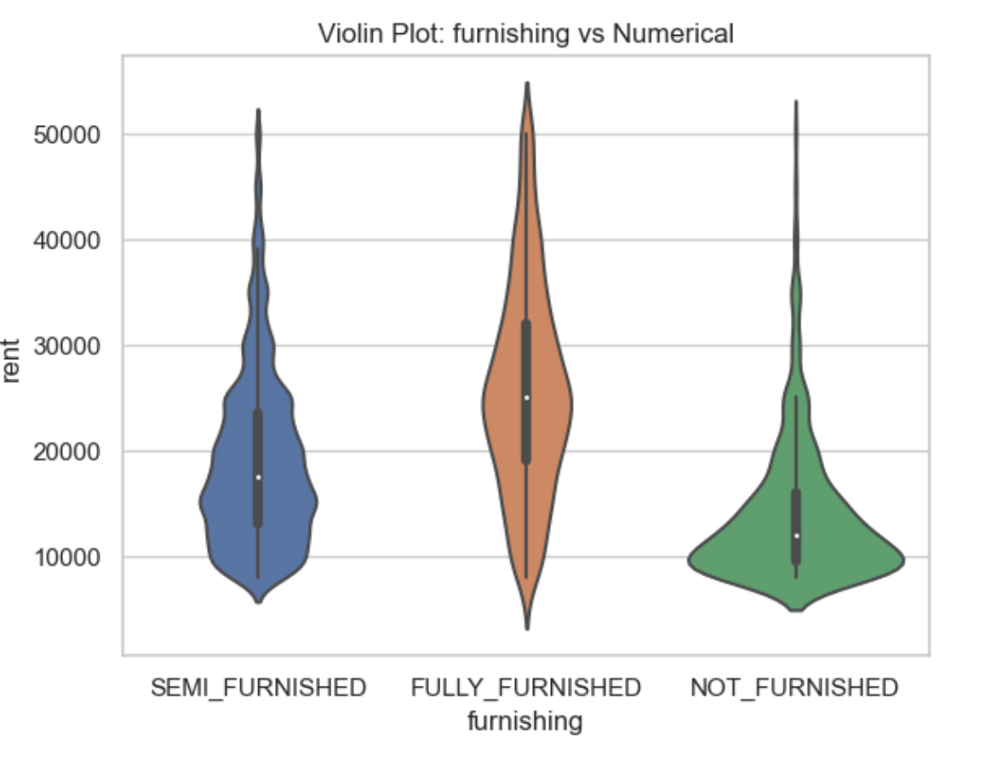
- Does the furnishing level (fully furnished, partially furnished, unfurnished) influence the rent?

Slide 9
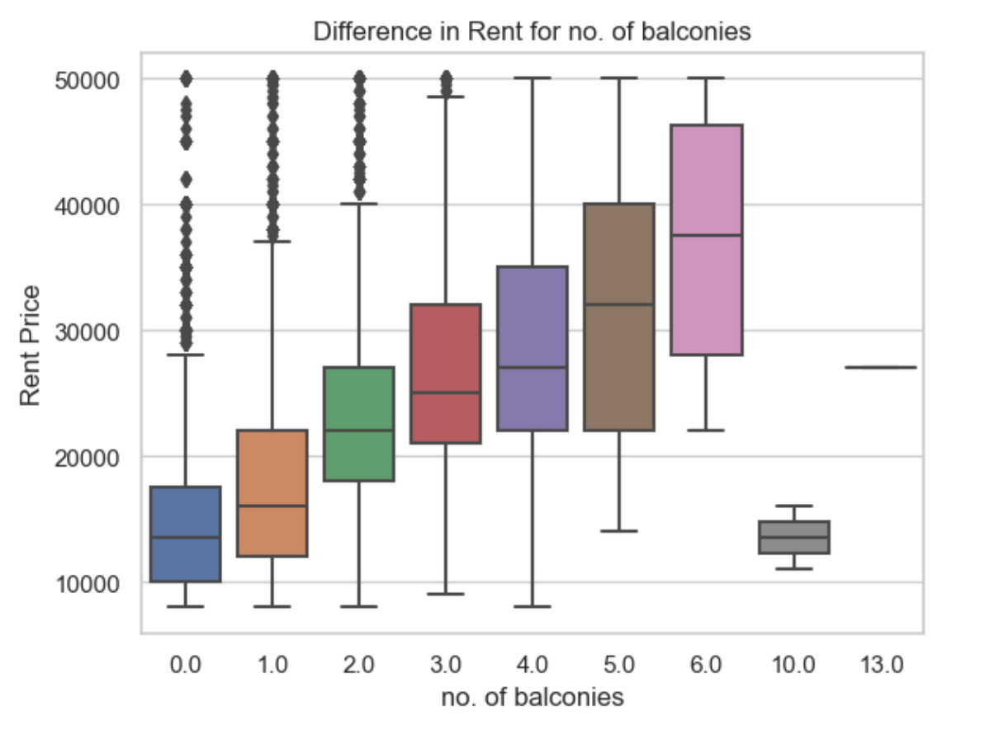
Building Characteristics:
- How does the number of balconies in a property impact its rent price?

Slide 10
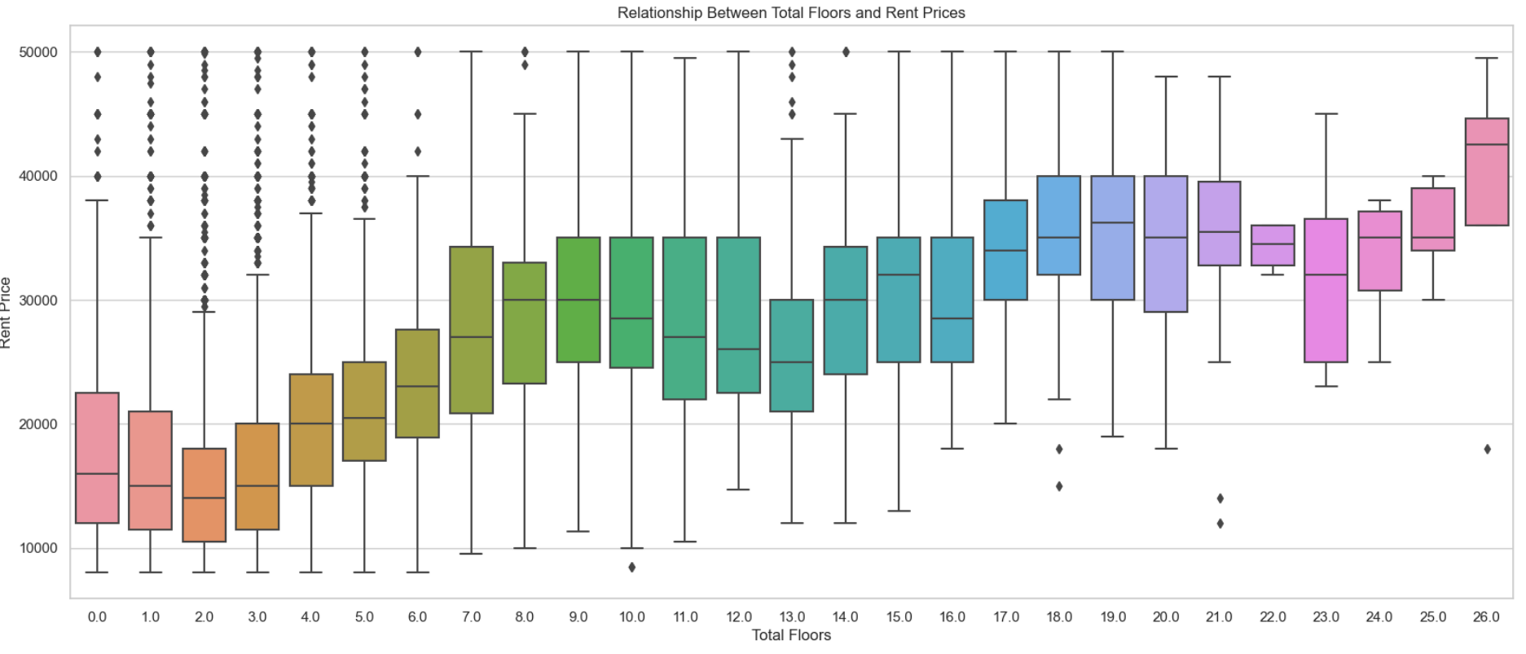
- How does the number of total floors in a building relate to the rent price?
plt.figure(figsize=(20, 8))
sns.boxplot(x='total_floor', y='rent', data=data)

Slide 11
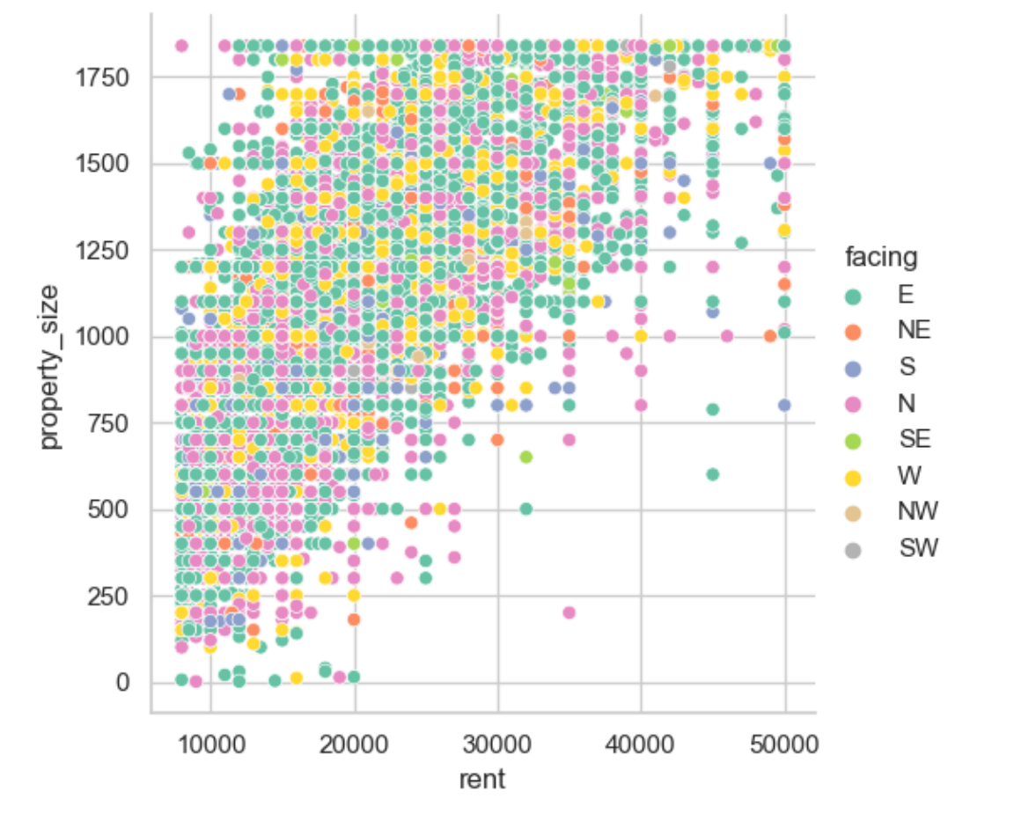
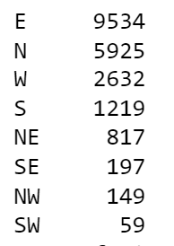
- Is there a correlation between the property's facing direction and rent price?
Correlation between facing and rent price: -0.0513664

Slide 12
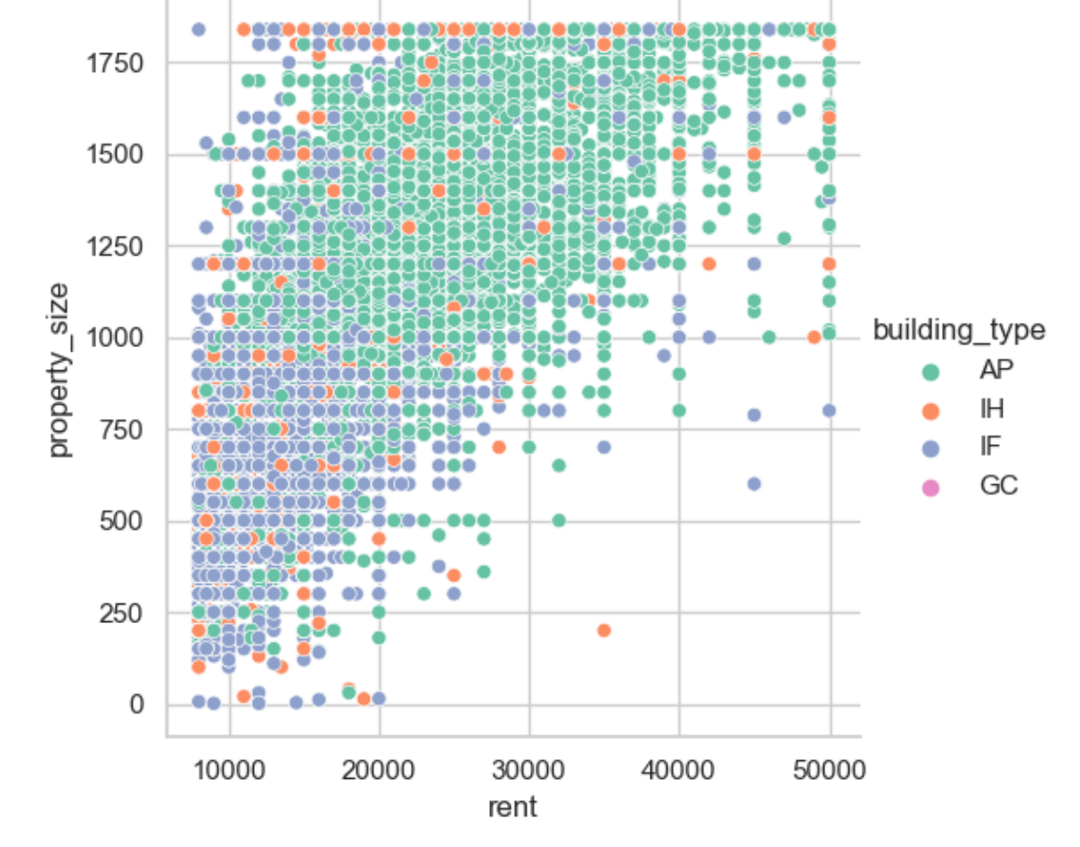
- Does the building type (e.g., IH, AP) have an influence on rent prices?

Slide 13
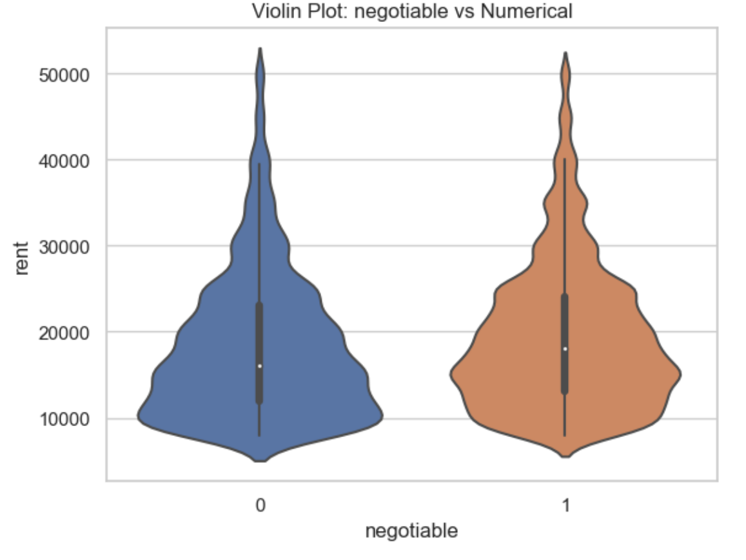
Negotiability and Rent:
- Do negotiable rent prices tend to be higher or lower than fixed rent prices?
Average rent with negotiable: 19392
Average rent without negotiable: 18229

Slide 14
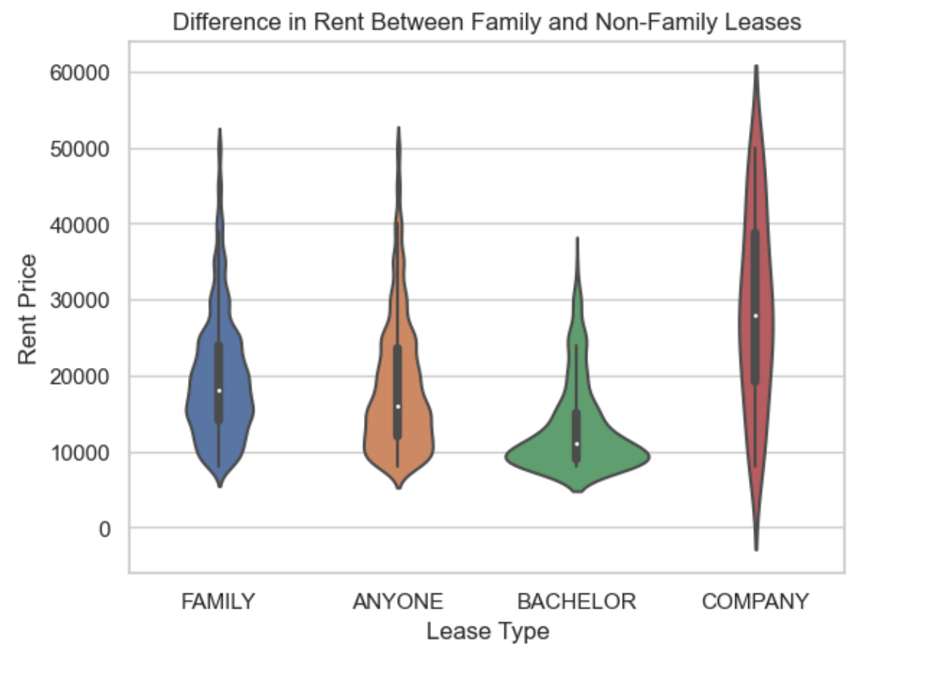
- Is there a difference in rent between family and anyone leases?

